Slide 1
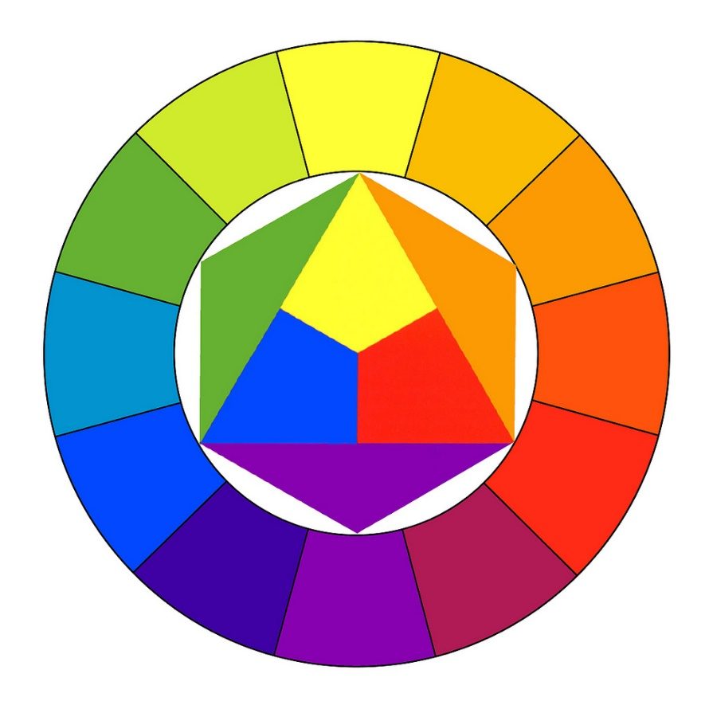

Colour Theory

Slide 2

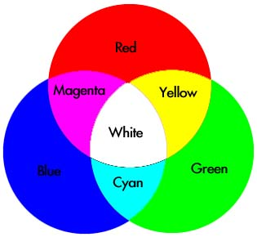
Colour Theory
Introduction
Colour theory encompasses a multitude of definitions, concepts and design applications. However, there are three basic categories of colour theory that are logical and useful : The colour wheel, colour harmony, and the context of how colours are used.

Slide 3
Colour Theory
Content
Why Colour is Important
Primary, Secondary and Tertiary Colours
Colour Wheel
Terms
Models
Schemes(Harmonies)
Psychology
Perception
Contrast, Behaviour & Consistency

Slide 4
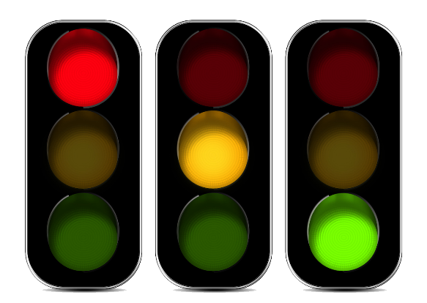
Colour Theory
Why Colour is Important
Colour plays a vitally important role in the world in which we live. Colour can sway thinking, change actions, and cause reactions. It can irritate or soothe your eyes, raise your blood pressure or suppress your appetite. When used in the right ways, colour can even save on energy consumption.
As a powerful form of communication, colour is irreplaceable. Red means "stop" and green means "go." Traffic lights send this universal message. Likewise, the colours used for a product, web site, business card, or logo cause powerful reactions.
Colour Matters!

Slide 5

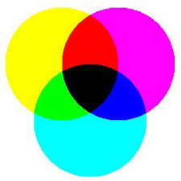
Colour Theory
Primary, Secondary and Tertiary Colours
Primary colours form the basis for all other shades. Humans perceive three base colours: magenta, cyan, and yellow. Every other colour we see consists of a combination of these three colours in varying amounts, brightness’s, tints, and shades.
Traditionally, we considered red, blue, and yellow to be the primary colours, but research has shown that magenta, cyan, and yellow better describe our experience of colour.
RYB
CMYK

Slide 6
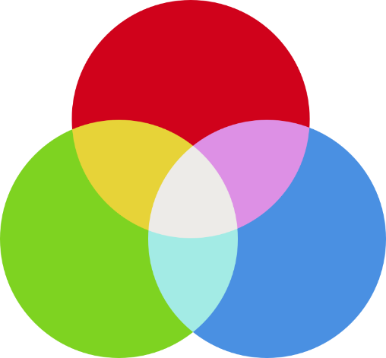
Colour Theory
Primary, Secondary and Tertiary Colours
When developing user interfaces for digital media, we use the primary colours Red, Green, Blue (RGB). The RGB colour system defines all colours as a combination of three different values: a particular shade of red, another of green, and another of blue.

Slide 7
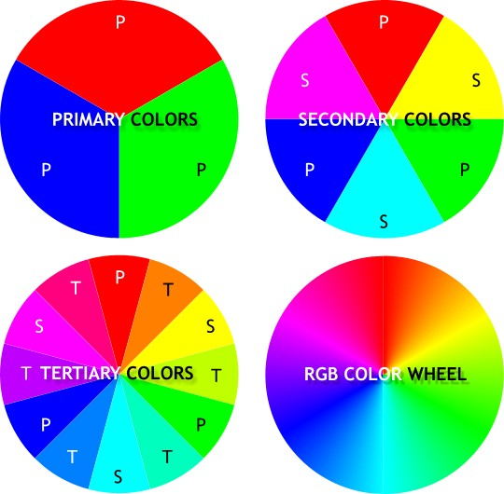
Colour Theory
Primary, Secondary and Tertiary Colours
Secondary colours (RGB): By mixing two primary colours together you create a secondary colour. There are three secondary colours.
Tertiary colours (RGB): The third set of colours are known as tertiary or intermediate colours. These colours are made by mixing adjacent primary and secondary colours.

Slide 8
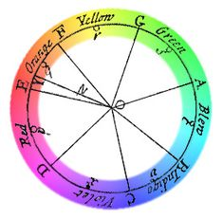
Colour Theory
Colour Wheel
The colour wheel or colour circle is the basic tool for combining colours. The first circular colour diagram was designed by Sir Isaac Newton in 1666.
The colour wheel is designed so that virtually any colours you pick from it will look good together. Over the years, many variations of the basic design have been made, but the most common version is a wheel of 12 colours.

Slide 9
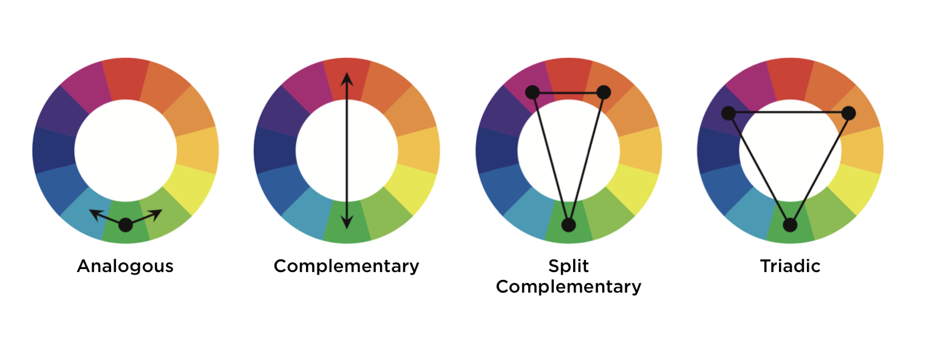
Colour Theory
Colour Wheel
Traditionally, there are a number of colour combinations that are considered especially pleasing. These are called colour schemes (harmonies) with a fixed relation in the colour wheel.

Slide 10
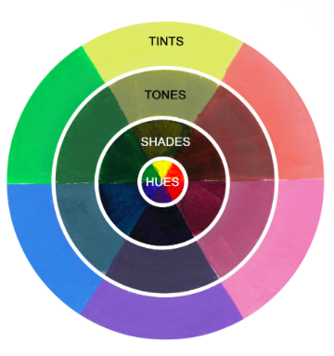
Colour Theory
Colour Terms
When using colours it is important to understand the different terms used. Terminology has evolved to help understand and discuss human responses to colour and its uses. Colours can be measured and classified in terms of various properties, including:
Colour
Hue
Saturation(Intensity)
Shade
Tone
Tint
Value

Slide 11
Colour Theory
Colour Terms - Colour
Before we step any further, it’s important to figure out the essence of colour itself. The Collins English dictionary defines it as “The colour of something is the appearance that it has as a result of the way in which it reflects light. Red, blue, and green are colours”.
Simply put, colour is a quality of an object which is caused due to the light being reflected or emitted by this object. Colour can be verified visually by measurement of its properties such as hue, saturation, tint and tone.

Slide 12
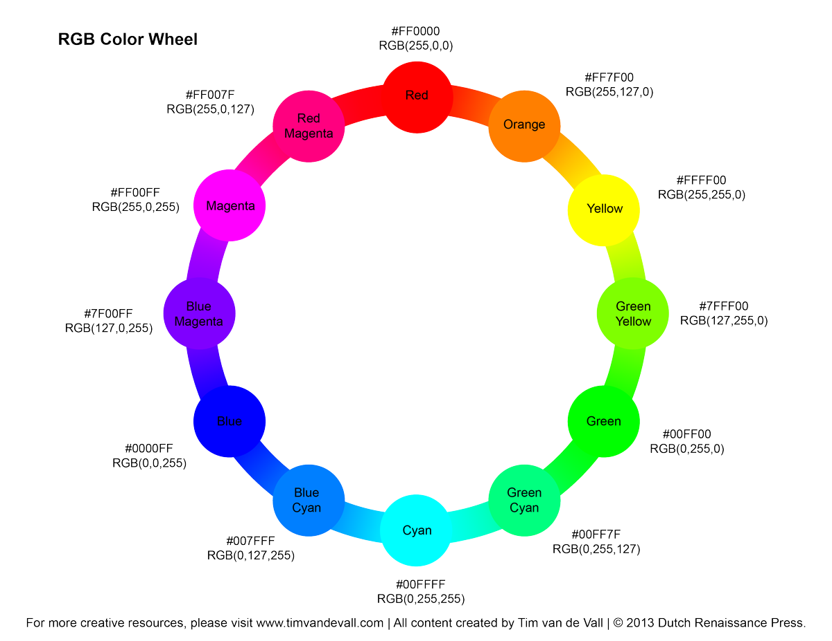
Colour Theory
Colour Terms - Hue
This is the actual named colour, such as green, red orange. Hues are pure colours with no black or white added. Adding more of the same colour may increase the intensity, but will not change the hue.
So when you describe a colour as “greenish blue,” you’re defining it in terms of two hues.

Slide 13
Colour Theory
Colour Terms – Saturation (Intensity)
Saturation defines the intensity of a colour in an image, its brightness or dullness. The official definition is expressed as “the degree to which a colour differs from white.”
Saturation describes the intensity (purity) of a hue. When colour is fully saturated, the colour is considered in purest (truest) version. Primary colours red, blue and yellow are considered truest version colour as they are fully saturated.
As the saturation increases, the colours appear to be more pure. As the saturation decreases, the colours appear to be more washed-out or pale.

Slide 14
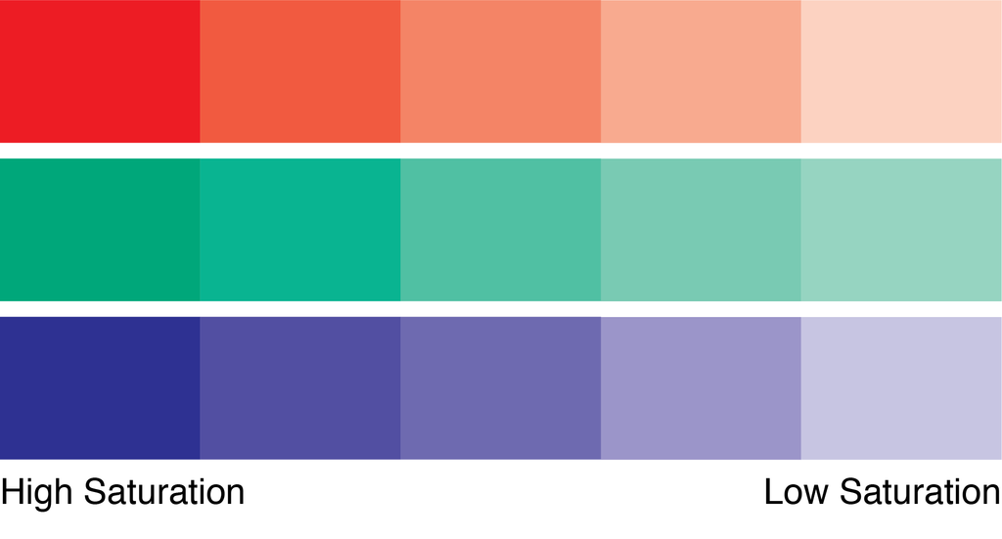
Colour Theory
Colour Terms – Saturation (Intensity)

Slide 15
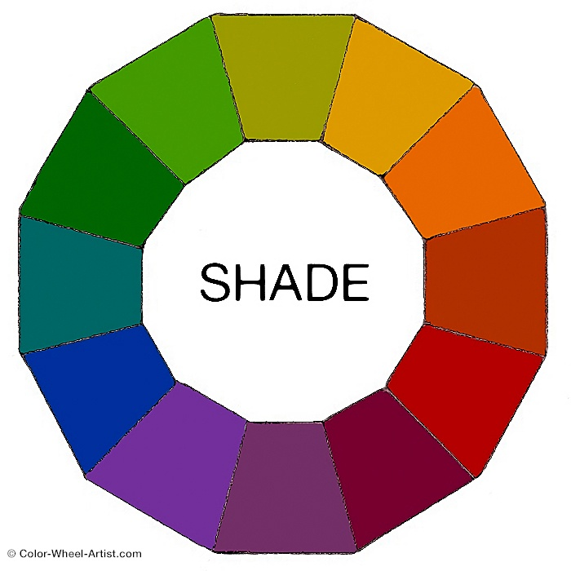
Colour Theory
Colour Terms – Shade
Shade​ is any pure hue or mixture of pure colours with only black added. In other words, it contains absolutely no white or grey. A shade darkens the colour. It remains the same hue only a darker version.
Therefore a Shade can range from slightly darker than your original colour, all the way to nearly Black with barely any of the colour mixed in.

Slide 16
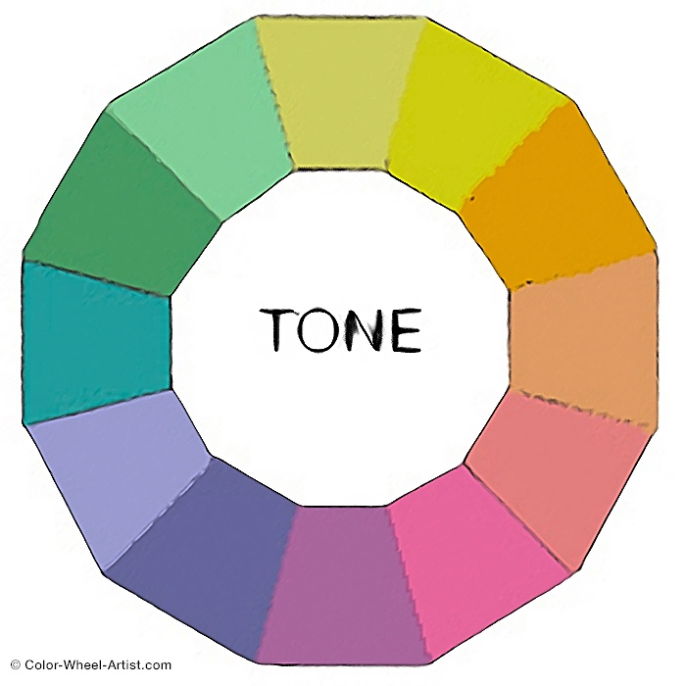
Colour Theory
Colour Terms – Tone
Tone is any hue or mixture of pure colours with only grey added. This definition considers grey as truly neutral. In other words, there are no additional pigments in the grey other than White plus Black.
A neutral mixture of grey, no matter how light or dark, will tone down the intensity of any colour.

Slide 17
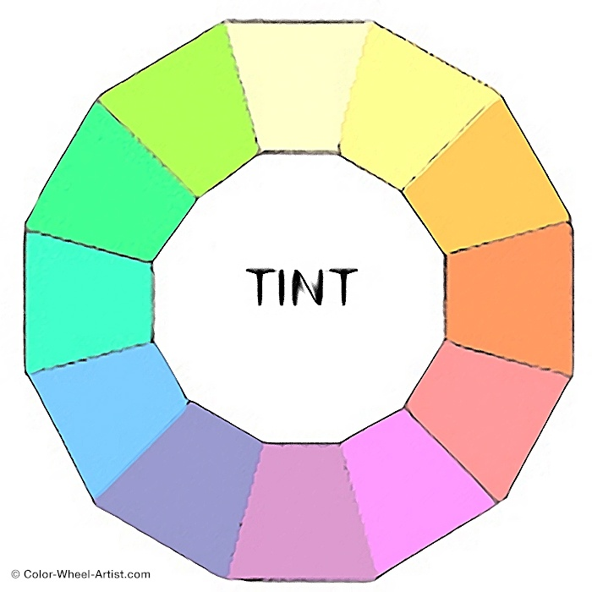
Colour Theory
Colour Terms – Tint
Tint is any hue or mixture of pure colours with only White added. A tint lightens the colour, but it doesn't make it brighter. Even a small amount of white added to a colour, transforms it into a tint.
Therefore a tint can range from slightly lighter than your original colour, all the way to white with barely any of the colour mixed in.

Slide 18
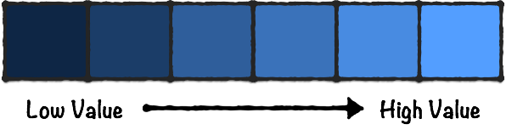
Colour Theory
Colour Terms – Value
Value is defined as the relative lightness or darkness of a colour. Value refers to the differences between shades of colours and tints of colours.

Slide 19
Colour Theory
Colour Models
A colour model is an orderly system for creating a whole range of colours from a small set of primary colours. There are two types of colour models: additive and subtractive.
Additive colour models use light to display colour, while subtractive colour models use printing inks. The most common colour models that graphic designers work with are the CMYK model for printing and the RGB model for computer display.
RGB
CMYK
HSB/HSL

Slide 20

Colour Theory
Colour Models - RGB
The RGB colour model is an additive colour model. In this case red, green and blue light are added together in various combinations to reproduce a wide spectrum of colours. The primary purpose of the RGB colour model is for the display of images in electronic systems, such as on television screens and computer monitors and it’s also used in digital photography.

Slide 21
Colour Theory
Colour Models - RGB
For web-page design the colours used are commonly specified using RGB. Today, with the predominance of 24-bit displays, it enables most users to see 16.7 million colours of HTML RGB code. In web page design, there are 216 so-called ‘web-safe’ RGB colours represented by hexadecimal values. Quite simply, the web-safe colour palette consists of the 216 combinations of red, green and blue.

Slide 22
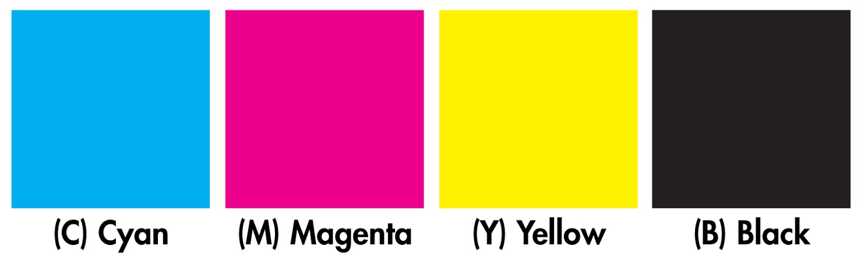
Colour Theory
Colour Models - CMYK
The CMYK colour model (four-color process) is a subtractive colour model. Primarily used in printing, CMYK works by partially or completely masking colours on a white background. The printed ink reduces the light that would otherwise be reflected. That’s why this model is called subtractive because inks ‘subtract’ brightness from a white background from four colours: cyan, magenta, yellow and black.

Slide 23
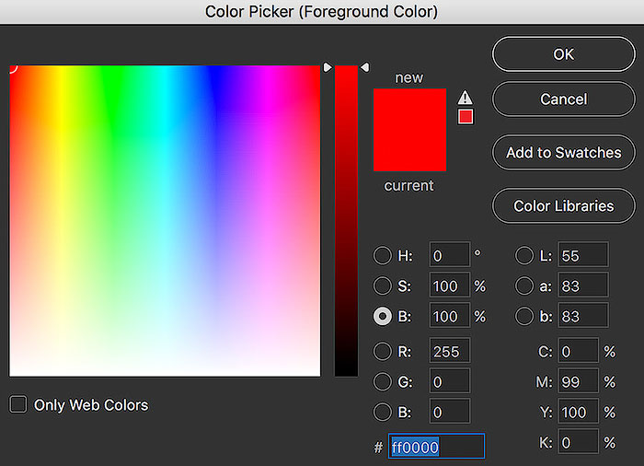
Colour Theory
Colour Models – HSB/HSL
The HSB (Hue, Saturation and Brightness) model reflects the way humans perceive colour. We are far more sensitive to brightness than hue. Hue, saturation and brightness (or brilliance) are the three basic colour components which can be varied to create any colour.
The HSB model is derived from the HSL model, in which Luminance is used to describe the intensity of the colour.
Computer graphics applications usually allow a colour to be defined by entering values for hue, saturation and brightness. Typically these values are percentage figures.

Slide 24
Colour Theory
Colour Scheme (Harmonies)
The colour balance is vital in design since users make their impression of the website or application by the first look, and colours have the big influence. Designers distinguished the basic colour schemes, aka colour harmony, which work effectively.
There are a number of classic colour schemes:
Monochromatic
Analogous
Complementary
Split Complementary
Triadic
Tetradic

Slide 25
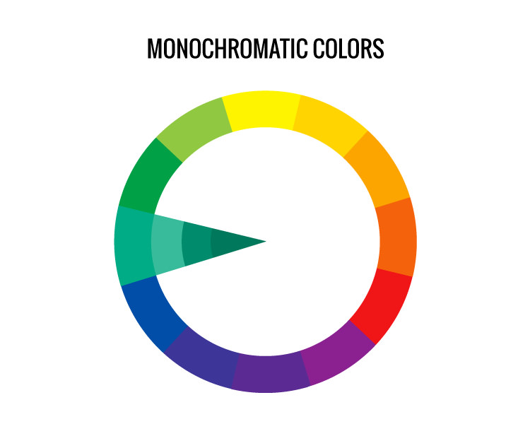
Colour Theory
Colour Scheme - Monochromatic
It is based on one colour with various tones and shades of it. The monochromatic harmony is always a winning choice since it’s hard to make a mistake and create the distasteful colour scheme. Photography websites use a monochromatic colour scheme to focus the viewer’s attention to the images, adding to the mood and atmosphere of the photograph.

Slide 26

Colour Theory
Colour Scheme - Monochromatic

Slide 27
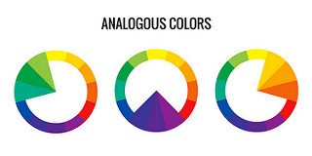
Colour Theory
Colour Scheme - Analogous
Analogous colour schemes use colours that are next to each other on the colour wheel. They usually match well and create serene and comfortable designs. Analogous colour schemes are often found in nature and are harmonious and pleasing to the eye. Make sure you have enough contrast when choosing an analogous colour scheme. Choose one colour to dominate, a second to support. The third colour is used (along with black, white or grey) as an accent.

Slide 28
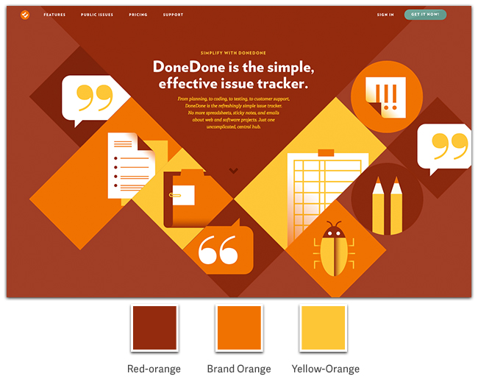
Colour Theory
Colour Scheme - Analogous

Slide 29
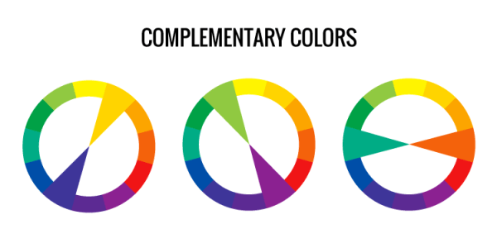
Colour Theory
Colour Scheme - Complementary
Colours that are opposite each other on the colour wheel are considered to be complementary colours (example: red and green). The high contrast of complementary colours creates a vibrant look especially when used at full saturation. This colour scheme must be managed well so it is not jarring. Complementary colours are tricky to use in large doses, but work well when you want something to stand out. Complementary colours are really bad for text.

Slide 30

Colour Theory
Colour Scheme - Complementary

Slide 31
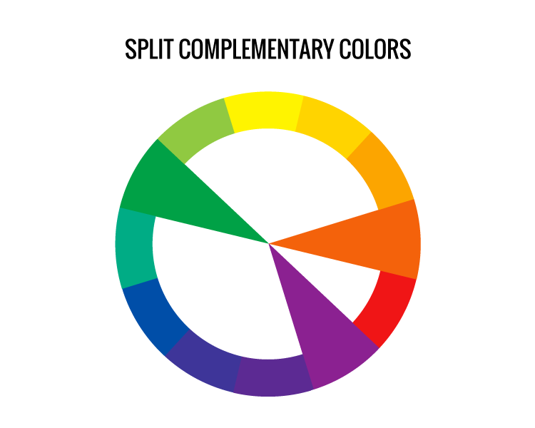
Colour Theory
Colour Scheme – Split-Complementary
The split-complementary colour scheme is a variation of the complementary colour scheme. In addition to the base colour, it uses the two colours adjacent to its complement.
This colour scheme has the same strong visual contrast as the complementary colour scheme, but has less tension. The split-complimentary colour scheme is often a good choice for beginners, because it is difficult to mess up.

Slide 32

Colour Theory
Colour Scheme – Split-Complementary

Slide 33
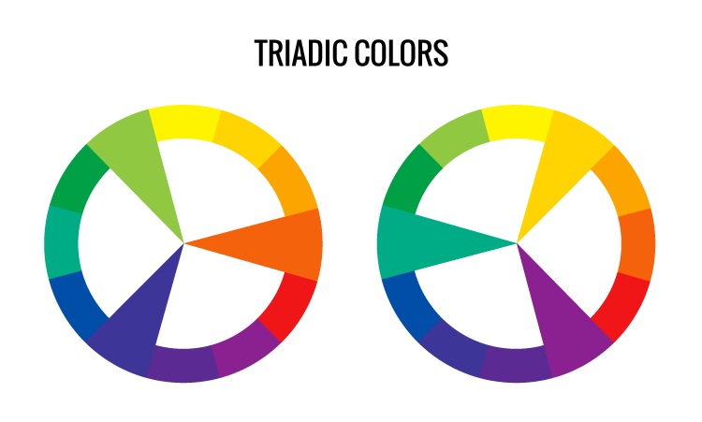
Colour Theory
Colour Scheme – Triadic
A triadic colour scheme uses colours that are evenly spaced around the colour wheel. Triadic colour harmonies tend to be quite vibrant, even if you use pale or unsaturated versions of your hues. To use a triadic harmony successfully, the colours should be carefully balanced - let one colour dominate and use the two others for accent.

Slide 34
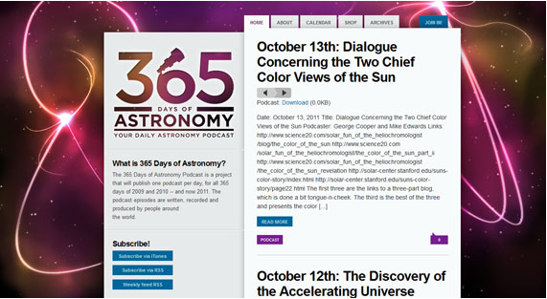
Colour Theory
Colour Scheme – Triadic

Slide 35
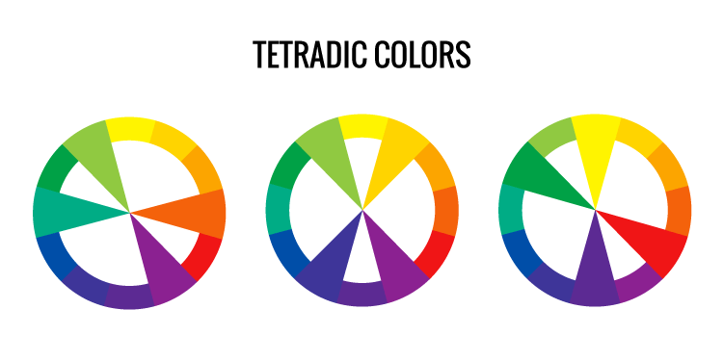
Colour Theory
Colour Scheme – Tetradic
The tetradic colour or rectangle scheme uses four colours arranged into two complementary pairs. This rich colour scheme offers plenty of possibilities for variation.
The tetradic colour scheme works best if you let one colour be dominant. You should also pay attention to the balance between warm and cool colours in your design.

Slide 36

Colour Theory
Colour Scheme – Tetradic

Slide 37
Colour Theory
Colour Psychology
Colour is the most effective attribute of objects and images in producing an emotional response.
These associations hold true only for some parts of the world, and it is important to consider the other associations when designing for a target audience which transcends cultural boundaries.
What doe these colours say to you?

Slide 38

Colour Theory
Colour Psychology
Our response to colour is highly subjective, affected by personal experience and cultural conditioning. It provides a powerful means of communication. For these reasons, interface developers should devote much of their efforts to an understanding of colour and the expected response from an application's target users.

Slide 39
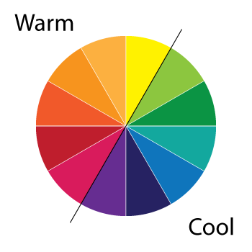
Colour Theory
Colour Psychology
Despite the personal differences in our response to colour, we can state some general rules. Colours such as red, orange and yellow, which we may perceive as warm colours, will appear to be closer than cooler colours such as blue and green. Lighter, pastel colours are seen as relaxing and cheerful, whereas darker colours convey darker emotions such as anger and depression.
Warm colours are useful for grabbing attention, for example when the user is required to carry out some action. Cool colours such as blue are more suitable for backgrounds.

Slide 40
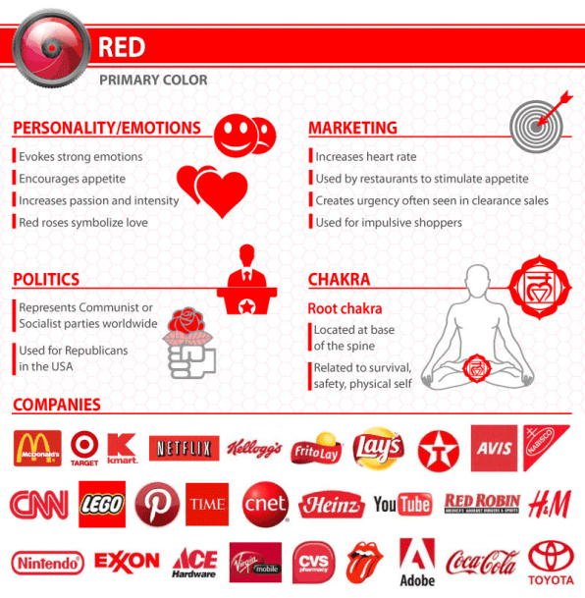
Colour Theory
Colour Psychology - Red
Red is often associated with the heat of sun and fire and is considered a high-arousal colour, often stimulating people to take risks, according to colour think tank, Pantone. It has also been shown to stimulate the senses and raise blood pressure, and it may arouse feelings of power, energy, passion, love, aggression, or danger.

Slide 41
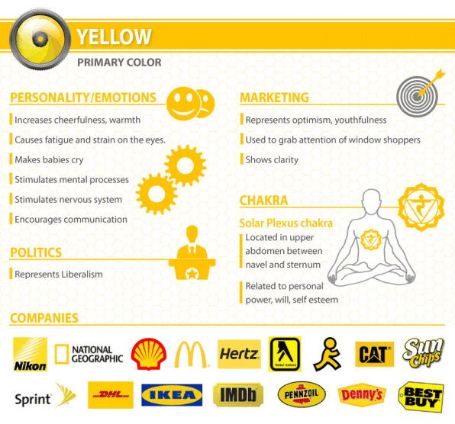
Colour Theory
Colour Psychology - Yellow
Yellow is often associated with the heat of sun and fire and is considered a high-arousal colour. It may stimulate feelings of optimism, hope, positivity and energy or cowardice and betrayal.

Slide 42
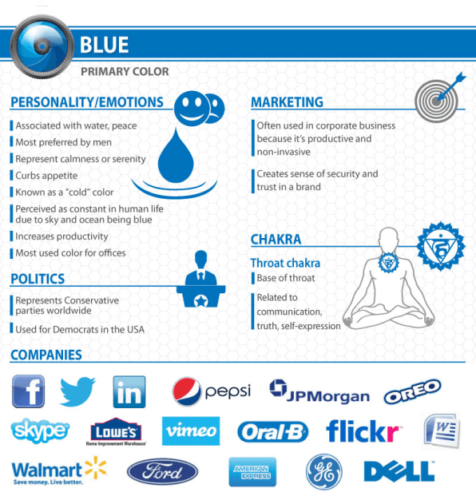
Colour Theory
Colour Psychology - Blue
Blue is often associated with the coolness of the sea and sky. It has been shown to calm the senses and lower blood pressure. It may stimulate feelings of trust, security, order, and cleanliness.

Slide 43
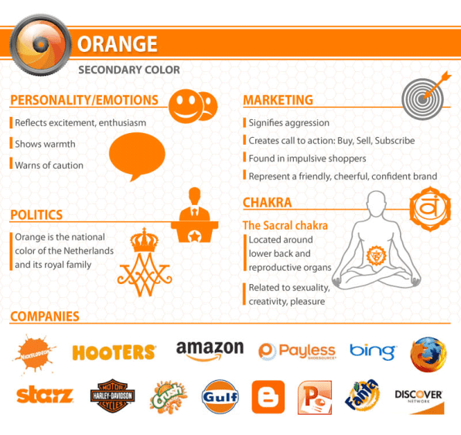
Colour Theory
Colour Psychology - Orange
Orange is often associated with the heat of sun and fire and is considered a high-arousal colour. It may stimulate feelings of energy, balance, and warmth.

Slide 44
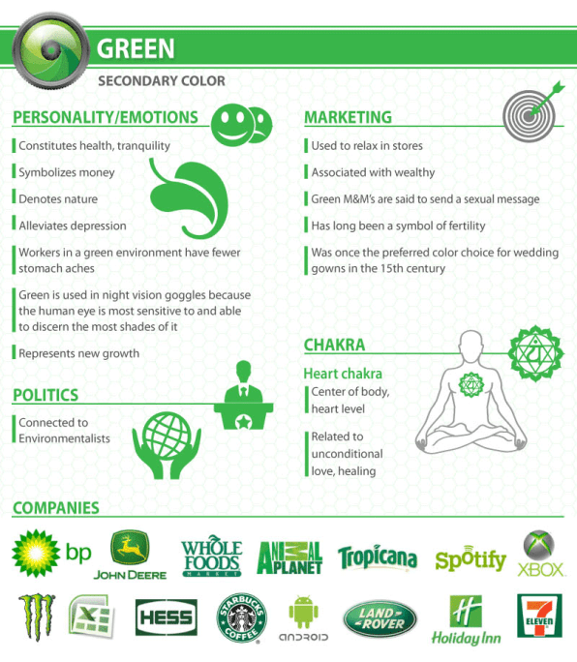
Colour Theory
Colour Psychology - Green
Green is often associated with the coolness of leaves. People often associate it with nature, health, good luck, and jealousy.

Slide 45
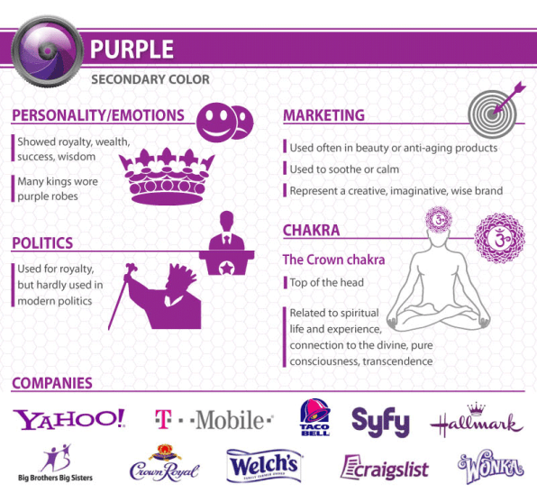
Colour Theory
Colour Psychology - Purple
Purple is generally considered a low-arousal colour. It may stimulate feelings of spirituality, mystery, royalty, or arrogance.

Slide 46
Colour Theory
Colour Perception
Human eyes register different wavelengths of light very differently. Violet has a short wavelength and high frequency, but is barely perceived by the human eye. Red has a long wavelength and low frequency, but is seen very well. Red tends to dominate the sensation of other colours, which accounts for its use in traffic lights, stop signs and other warning devices.

Slide 47
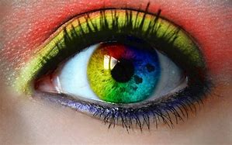
Colour Theory
Colour Perception
This domination is due to the cornea being coloured yellow to protect it from harmful ultraviolet rays. Yellow absorbs the shorter wavelength colours such as green, blue and violet. With age, the cornea becomes more yellow, so greens and blues are less visible to older people. This relationship between age and colour perception should be borne in mind if the intended audience for an application is from an older age group.

Slide 48

Colour Theory
Colour Perception
What number can you see?

Slide 49
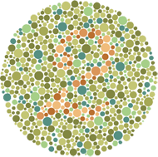
Colour Theory
Colour Perception
What number can you see?

Slide 50
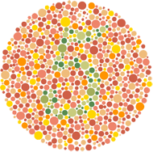
Colour Theory
Colour Perception
What number can you see?

Slide 51

Colour Theory
Colour Contrast
On a web page, the amount of contrast required varies with different parts of the page. You usually want a high contrast between text and its background colour. But too high contrast between design elements might give an unsettled and messy impression. Black and white create the highest contrast possible.

Slide 52
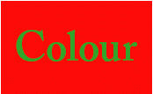
Colour Theory
Colour Behaviour
How colours behave when near each other is an important consideration for any developer. Adjacent complementary or clashing colours can cause the appearance of vibration in the eyes of your users, and because of this, care should be taken when using such schemes. The eye cannot handle so much information, so we see quivering or optical distortion when complements are used near each other.

Slide 53
Colour Theory
Colour Consistency
Whatever colour scheme you choose, it should be implemented consistently throughout the interface. Users will perceive subtle meanings in the way colour is used across sections of an application to associate items or emphasise their differences, or to indicate warnings. They will also notice, and be confused by, inconsistencies in the use of colour coding.

Slide 54

Colour Theory
Colour Consistency
Brand recognition is crucial for a successful company, and colour is one of the easiest ways to implement consistency across all of your visual media.

Slide 55
Colour Theory
Summary
With proper planning and a clever use of colour theory and colour contrasts you can create a really cool website with a great UI.

Slide 56
Colour Theory
References
Design your way. 2018. Colors And Contrast In User Interface Design. [ONLINE] Available at: https://www.designyourway.net/blog/design/colors-and-contrast-in-user-interface-design/. [Accessed 2 December 2018].
Lisa Mardar. 2018. Mixing Colors: What You Need to Know About Tints, Tones, and Shades. [ONLINE] Available at: https://www.thoughtco.com/tints-tones-and-shades-3862946. [Accessed 2 December 2018].
Steven Bradley. 2013. The Fundamentals of Color: Hue, Saturation, And Lightness. [ONLINE] Available at: https://vanseodesign.com/web-design/hue-saturation-and-lightness/. [Accessed 3 December 2018].
Angela Wright. 2018. Psychological Properties Of Colours. [ONLINE] Available at: http://www.colour-affects.co.uk/psychological-properties-of-colours. [Accessed 3 December 2018].
Graf1x. 2018. Color Meaning and Psychology of Red, Blue, Green, Yellow, Orange, Pink and Violet colors.. [ONLINE] Available at: https://graf1x.com/color-psychology-emotion-meaning-poster/. [Accessed 3 December 2018].
Tubik Studio. 2018. Color Glossary for Designers: Terms and Definitions.. [ONLINE] Available at: https://uxplanet.org/color-glossary-for-designers-terms-and-definitions-1a65549804bd. [Accessed 4 December 2018].

Slide 57
Colour Theory
References
Michael Maher. 2016. Color Theory for Motion Design. [ONLINE] Available at: https://www.rocketstock.com/blog/color-theory-for-motion-design/. [Accessed 4 December 2018].
Color Wheel Artist. 2018. The Ultimate Guide to Understanding Hue, Tint, Tone and Shade. [ONLINE] Available at: https://color-wheel-artist.com/hue/. [Accessed 4 December 2018].
Richard Hall. 2018. Mixing and Matching Colors. [ONLINE] Available at: http://web.mst.edu/~rhall/web_design/color_mixing.html. [Accessed 4 December 2018].
NickKolenda. 2018. Color Psychology. [ONLINE] Available at: https://www.nickkolenda.com/color-psychology/. [Accessed 4 December 2018].
Designer Insights. 2018. Understanding Color Models and Spot Color Systems. [ONLINE] Available at: https://www.designersinsights.com/designer-resources/understanding-color-models/. [Accessed 6 December 2018].
Tiger Color. 2017. Basic color schemes - Introduction to Color Theory. [ONLINE] Available at: http://www.tigercolor.com/color-lab/color-theory/color-theory-intro.htm#tints_shades_tones. [Accessed 6 December 2018].

Slide 58
Colour Theory
References
speekyboy. 2010. Beginners Guide to Using the Power of Color in Web Design. [ONLINE] Available at: https://speckyboy.com/beginners-guide-to-using-the-power-of-color-in-web-design/. [Accessed 6 December 2018].
Rachel Gillet. 2014. What Your Logo’s Color Says About Your Company (Infographic). [ONLINE] Available at: https://www.fastcompany.com/3028378/what-your-logos-color-says-about-your-company-infographic. [Accessed 6 December 2018].
Neil Patel. 2018. The Art of Color Coordination. [ONLINE] Available at: https://neilpatel.com/blog/art-of-color-coordination/. [Accessed 6 December 2018].
Color Psycholgy. 2018. The Psychology and Meaning of Colors. [ONLINE] Available at: https://www.colorpsychology.org/. [Accessed 6 December 2018].

Slide 59
End of Presentation

